Slide 1
Module 2: Visual Tools for Machine Learning
Notes:
While most professional data scientists and machine learning engineers use code, predominantly Python, to train machine learning models; the use of "no-code" (or "low-code") tools to quickly experiment and build prototype (and in some cases production) models has become more common as the sophistication and capabilities of these tools has evolved.

Slide 2
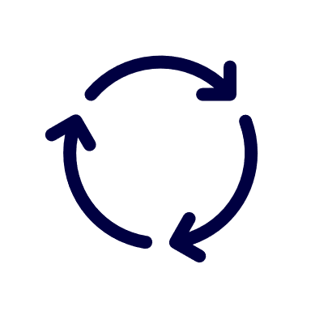
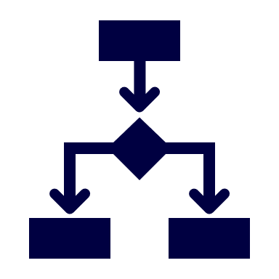
Agenda
Automated Machine Learning
Azure Machine Learning Designer
Notes:
In this module, we'll look at two no-code capabilities in Azure Machine Learning:
The Automated Machine Learning interface
Azure Machine Learning designer

Slide 3
Automated Machine Learning
Notes:
Let's start by exploring Automated Machine Learning

Slide 4







What is Automated Machine Learning?
Train multiple models in parallel, varying algorithm and preprocessing
Find the "best" model based on a specific performance metric

Notes:
Automated Machine Learning enables you to try multiple algorithms and preprocessing transformations with your data. This, combined with scalable cloud-based compute makes it possible to find the best performing model for your data without the huge amount of time-consuming manual trial and error that would otherwise be required.
The automated machine learning capability in Azure Machine Learning supports supervised machine learning models - in other words, models for which the training data includes known label values. You can use automated machine learning to train models for:
- Classification (predicting categories or classes)
- Regression (predicting numeric values)
- Time series forecasting (regression with a time-series element, enabling you to predict numeric values at a future point in time)
The "best" performing model is identified based on the model-type specific metric you specify.

Slide 5
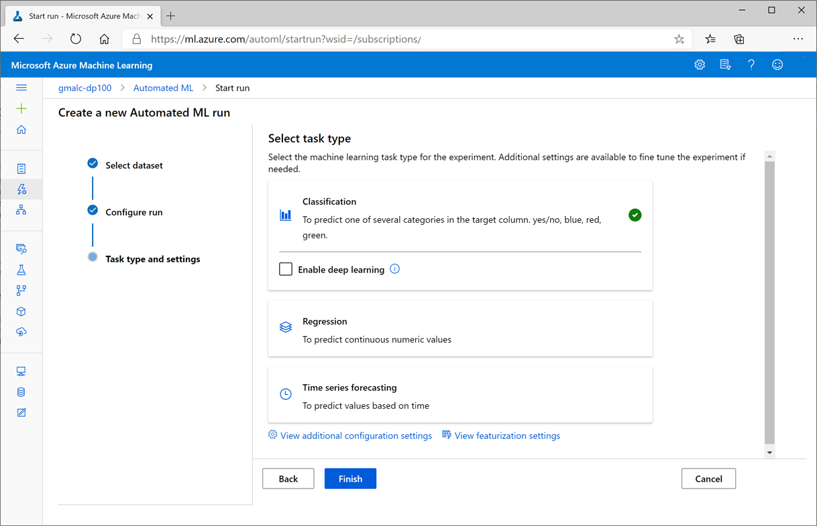
Automated ML in Azure Machine Learning Studio
Select dataset
Upload files
Import from Web
Register data source
Configure run
Experiment name
Target label
Compute
Task type and settings
Classification
Regression
Time Series
Notes:
There are three main steps to run an automated machine learning experiment using the user interface:
1. Specify a dataset containing the features and label data you want to use to train the model.
2. Configure the automated machine learning experiment run – including its name, the target label you want to train a model to predict, and the compute target on which to run the experiment.
3. Select the task type (classification, regression, or time-series), configuration settings, and featurization settings you want to apply in the experiment.
Note: Students will see this for themselves in the lab!
Note: You can also use the Azure Machine Learning SDK to run automated machine learning experiments programmatically – we'll explore this later in the course.

Slide 6
Configuration and Featurization
Configuration Options
Primary metric (used to evaluate the best model)
Explain best model (generates feature importance)
Blocked algorithms (restricts training algorithms)
Exit criterion (enables early-stopping)
Validation (sets cross-validation technique)
Concurrency (sets number of parallel iterations)
Featurization
Normalization / scaling is automatic
Optional featurization includes:
Dropping high-cardinality features
Imputing missing values
Categorical encoding
Derived feature generation
Data guardrails mitigate unbalanced data
Notes:
You can use the following configuration settings to control the automated machine learning experiment:
The primary metric for which you want to optimize the model – for example, Accuracy. Different task types support different metrics.
Whether or not to generate feature importance explanations for the best model.
Blocking algorithms that you do not want the experiment to try.
Exit criterion to stop the experiment after a maximum amount of time or when a specific metric threshold is achieved.
The validation technique used to split training and test data to evaluate model performance.
The number of concurrent training runs.
Automated machine learning also supports data pre-processing, or featurization. It always tries various data normalization/scaling techniques and applies data guardrails to mitigate unbalanced data (for example, datasets where there are a significantly larger number of observations with one label value than another). You can optionally apply additional featurization techniques to individual columns, including dropping high-cardinality features (which tend not to be predictive), imputing missing values, encoding categorical features, and deriving features (for example, by splitting dates into day, month, and year features).

Slide 7

Lab: Use Automated Machine Learning
View the lab instructions at https://aka.ms/mslearn-dp100
Complete the Use Automated Machine Learning exercise
Notes:
Students can complete the lab using only a browser and the Azure subscription they created previously. The lab instructions are at the address on the slide.
Alternatively, if students are using a hosted environment to complete the lab, get them to start it and find ther appropriate exercise instructions..

Slide 8
Azure Machine Learning Designer
Notes:
If you need a little more control over the pipeline of tasks used to prepare data and train a model, you can use Azure Machine Learning designer to create a machine learning model in a drag & drop interface.

Slide 9
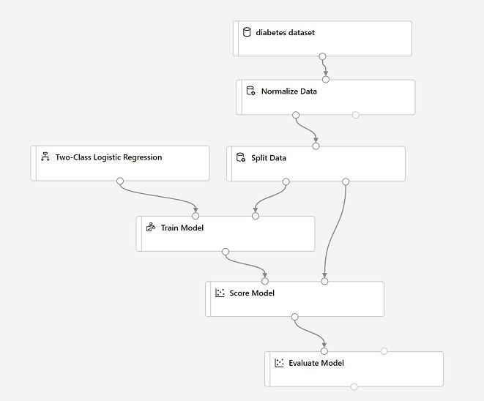
What is Azure Machine Learning Designer?
A visual interface for creating machine learning pipelines
Dataset
Module
Pipeline
Notes:
In Azure Machine Learning Designer, you define a dataflow for training a machine learning model as a pipeline. This pipeline includes all of the steps that are required to ingest and process the data, before using it to train a model. Each step is independently executable, and can be run on any valid compute target. The pipeline will manage the flow of execution, starting compute targets for each step as required.
Most pipelines to train models begin with a dataset from which the training data is ingested, and then each step in the pipeline is encapsulated in a module with inputs and outputs through which the data flows.

Slide 10
Training Pipelines
Data preparation, model training, scoring, and evaluation
Data preparation
Feature selection / engineering
Algorithm
Classification, Regression, Clustering
Score
Predict from test data
Train
Fit model for specified label
Evaluate
Model-specific metrics
Notes:
Azure Machine Learning Designer includes modules for training, scoring, and evaluating machine learning models. The specific details vary depending on the kind of model you are implementing, but the general approach is the same:
1. Use an algorithm module to specify the type of model to be trained. Azure Machine Learning Designer supports a range of algorithms for both supervised learning (classification and regression), and unsupervised learning (clustering).
2. Train the model by fitting the algorithm to the training data. For supervised learning algorithms, you must use the Train Model module and specify the label to be predicted from the features in the training data. For unsupervised clustering, you must use the Train Clustering Model module.
3. For a supervised learning algorithm, you typically split the data into a training set and a validation set, so after training the model with the training set you can use a Score Model module to predict labels for the validation set and evaluate the model. For an unsupervised clustering model, this step may be replaced by using the Assign Data to Clusters module to cluster a validation dataset.
4. You can evaluate model performance by using the Evaluate Model module to view metrics generated by scoring the test data. The specific metrics and associated visualizations vary depending on the type of model - for example, a binary classification model produces metrics for accuracy, precision, and recall as well as a Receiver Operator Characteristic (ROC) chart; while a regression model produces metrics such as Root Mean Squared Error (RMSE) and Coefficient of Determination (usually referred to as R<sup>2</sup>).
Note that the Evaluate Model module has two inputs, enabling you to train two models of the same type and evaluate them side-by-side to compare performance metrics.

Slide 11
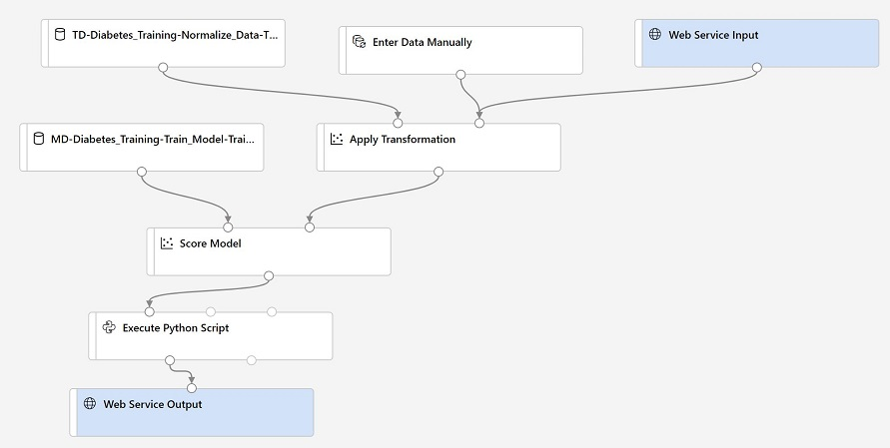
Inference Pipelines
Use the trained model to get predictions from new data
Transformations
Encapsulated in datasets based on training data statistics
Web Service Input
Defines input schema
Trained Model
Encapsulated in a Dataset
Web Service Output
Defines output schema
Notes:
Having trained a model using a training pipeline, you can use it to create an inference pipeline for either real-time or batch prediction. An inference pipeline encapsulates the steps required to use the trained model in a web service that predicts labels for new data. It differs from the training pipeline in the following respects: - A web service input defining an interface for new data to be scored is added to the beginning of real-time inference pipelines. By default, this is based on the schema of the training dataset.
- Steps that rely on statistics from the training data (such as feature normalization or categorical encoding) are encapsulated in transformation datasets that are applied to new data.
- The trained model is encapsulated in a dataset, removing the algorithm and model training modules.
- A Web service output containing the scored results is added at the end of real-time inferencing pipelines to define the output returned to applications consuming the service.
Before deploying an inference pipeline as a web service, you may want to make some changes to it. For example:
- For supervised learning models, consider replacing the training dataset at the beginning of the pipeline with an alternative data definition that does not include the label column. This has the effect of removing the label column from the web service input schema, which is more intuitive for client application developers (who would otherwise need to submit a value for the label that they want the model to predict).
- If you choose to remove the label column from the input schema, ensure it is not explicitly referenced in any other modules in the pipeline, as this will cause a runtime exception.
- Remove any modules that are not required - for example, if the training pipeline includes an Evaluate Model module, it will be included by default in the inference pipeline, even though it is not used.
- Consider filtering the output columns. The Score Model module returns its input data as well as the scored label and probability columns, so by default the web service will return all of these to the client application. The web service may be more efficient if you filter these to include only the required output, such as a row identifier and the scored label and probability.
- Consider adding parameters, which can be passed by calling applications to add flexibility to the pipeline. Typically, parameters are used to enable a choice of data sources to be used in the pipeline.

Slide 12





Publishing a Service Endpoint
Deploy a Real-Time Pipeline:
Specify deployment target:
Azure Container Instance
Azure Kubernetes Services Inference Compute
Submit new data to an HTTP endpoint for immediate results
Publish a Batch Pipeline
Runs on Azure Machine Learning Training Compute
Initiate a pipeline experiment run through an HTTP endpoint
Results are saved in the run output
Notes:
After creating and modifying an inference pipeline, you can publish an endpoint through which client applications can consume it as a web service.
For real-time inferencing, you must deploy the pipeline as a service on either an Azure Compute Instance (ACI) or an Azure Kubernetes Services (AKS) compute target. In general, you should use AKS for production services. The deployed pipeline service can then be accessed through an HTTP REST endpoint.
If you have created a batch inference pipeline, you can publish an HTTP endpoint through which the pipeline can be initiated. It will run on the Azure Machine Learning training compute target you have selected for the inference pipeline. It's important to note that batch inference pipelines are run on training compute, even when published as consumable services.

Slide 13
Lab: Use Azure Machine Learning Designer
View the lab instructions at https://aka.ms/mslearn-dp100
Complete the Use Azure Machine Learning Designer exercise
Notes:
Students can complete the lab using only a browser and the Azure subscription they created previously. The lab instructions are at the address on the slide.
Alternatively, if students are using a hosted environment to complete the lab, get them to start it and find ther appropriate exercise instructions..

Slide 14

Knowledge check
You want to use automated machine learning with car sales data to train a machine learning model that predicts the price of a car based on its make, model, engine size, and mileage.
What task type should you select?
Classification
Regression
Time-series
You are creating a training pipeline using a dataset that has multiple numeric columns. You want to transform the numeric columns so that the values are all on a similar scale.
Which module should you add to the pipeline?
Select Columns in a Dataset
Clean Missing Data
Normalize Data
Notes:
Use the slide animations to reveal the correct answers.

Slide 15
References
Microsoft Learn: Use visual tools to create machine learning models with Azure Machine Learning
https://docs.microsoft.com/learn/paths/create-no-code-predictive-models-azure-machine-learning
Automated Machine Learning documentation
https://docs.microsoft.com/azure/machine-learning/concept-automated-ml
Designer documentation
https://docs.microsoft.com/azure/machine-learning/concept-designer
Notes:
Use the references on the slide to learn more. In particular, note the online learning modules on Microsoft Learn that are related to the material covered in this module.

Slide 16
Closing slide

